Slide 1
Partial Network Cluster
Make by CVP MCU team

Slide 2
Glossary
Virtual Function Cluster (VFC): groups the communication on port level between SW-components that are required to realize one or more vehicle functions.This is the logical view and allows for a reusable bus/ECU independent design.
Partial Network Cluster (PNC): is a group of system signals necessary to support one or more vehicle functions that are distributed across multiple ECUs in the vehicle network.This represents the system view of mapping a group of buses to one more more VFCs.

Slide 3
Background
When read the document,Autosar network management is a prerequisite.Detail please read AUTOSAR_SWS_CANNetworkManagement.pdf
PNC is the mainstream technology for the development of CAN bus in the future.At present, BMW, Mercedes-Benz and Volvo have deployed PNC,and Geely is being deployed in China.
The PNC requriment need define by vehicle manufacturer,This effect the architecture of the vehicle.

Slide 4
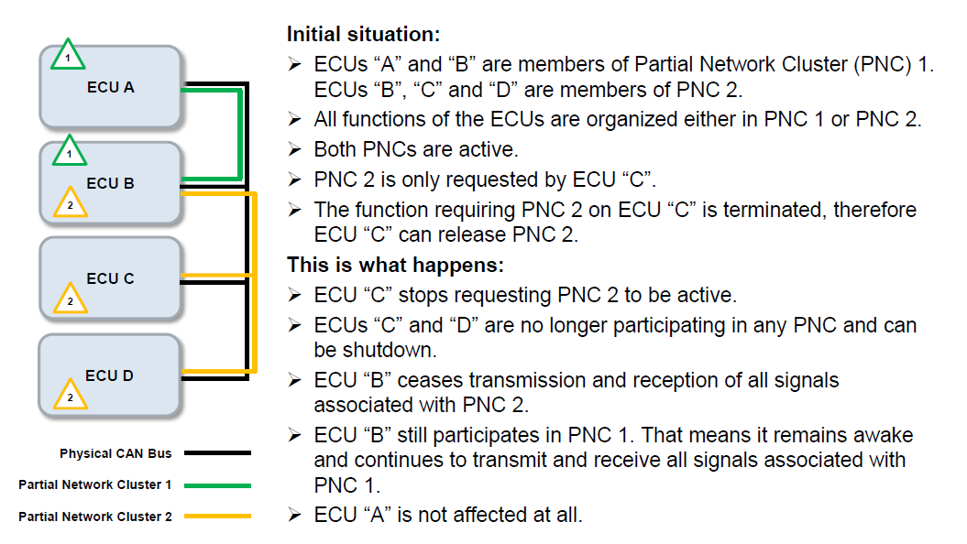

Overview

Slide 5
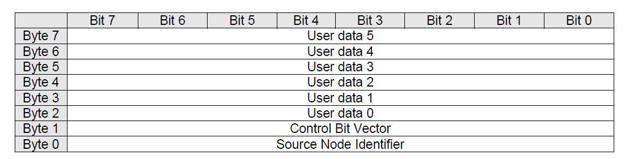
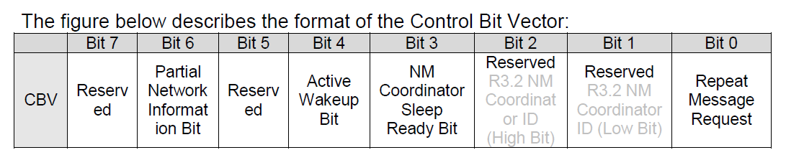
Network Management PDU Structure

Slide 6
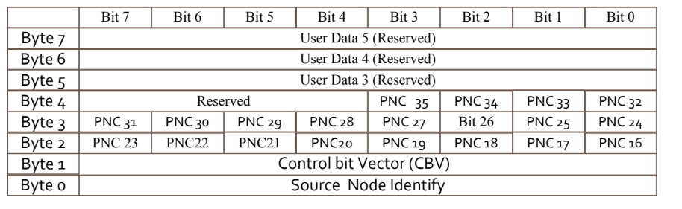
Network Management PDU Structure
PNC channel

Slide 7
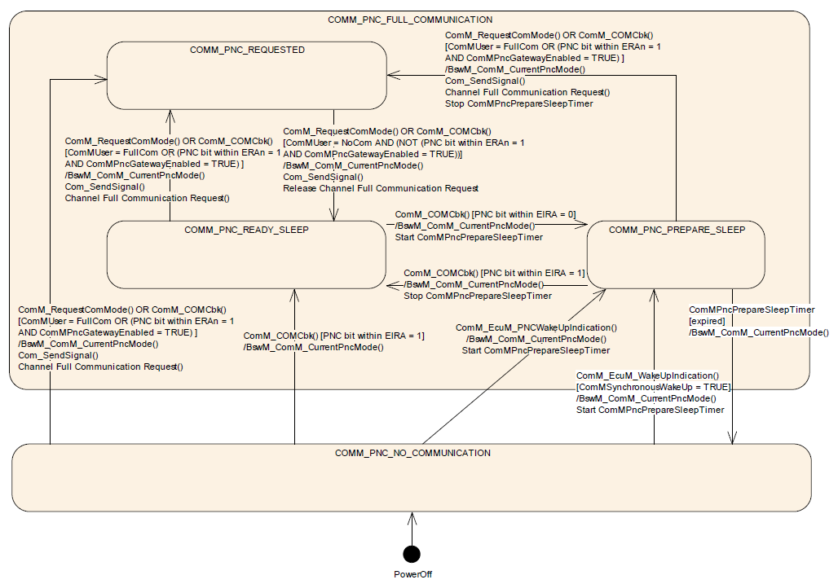
PNC State Machine

Slide 8
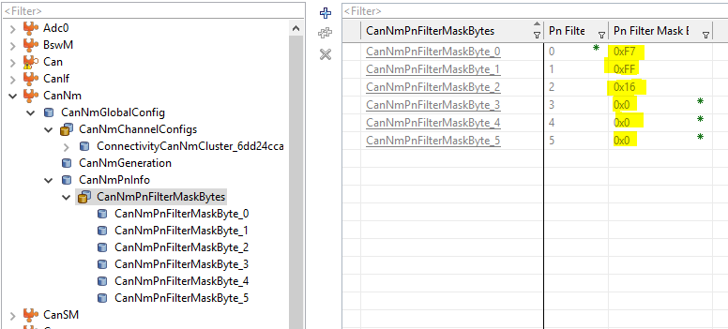
PNC implemented on DaVinciConfigurator
Config PnFilterMask on CanNM module

Slide 9
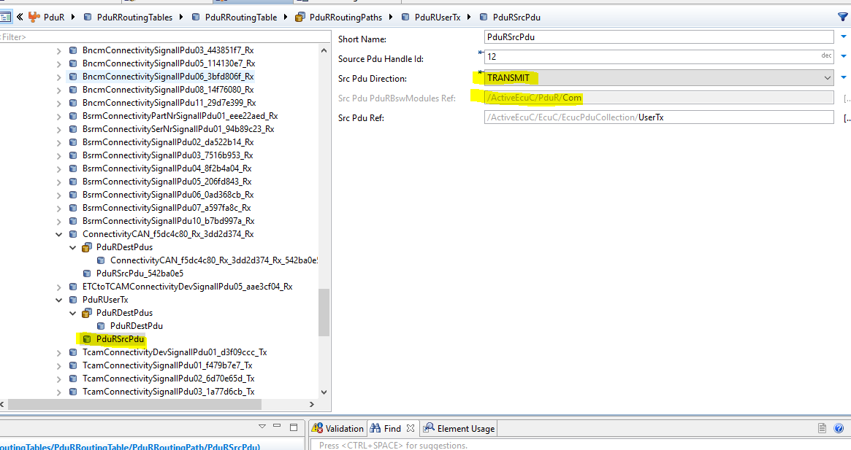
PNC implemented on DaVinciConfigurator
Config the NM user data from com to CAN NM on PduR module,target is com.

Slide 10
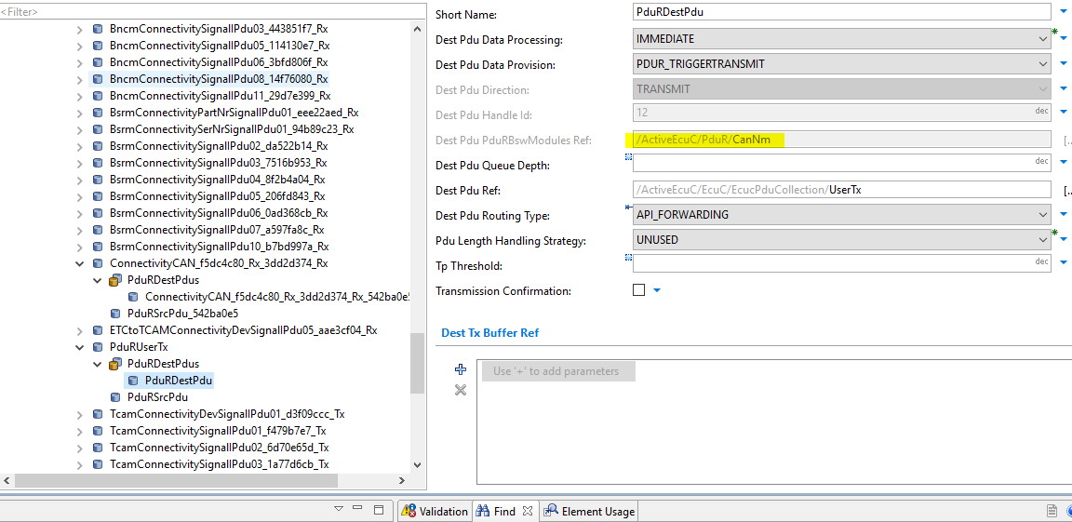
PNC implemented on DaVinciConfigurator
Config the NM user data from com to CAN NM on PduR module,destination is CAN NM.

Slide 11
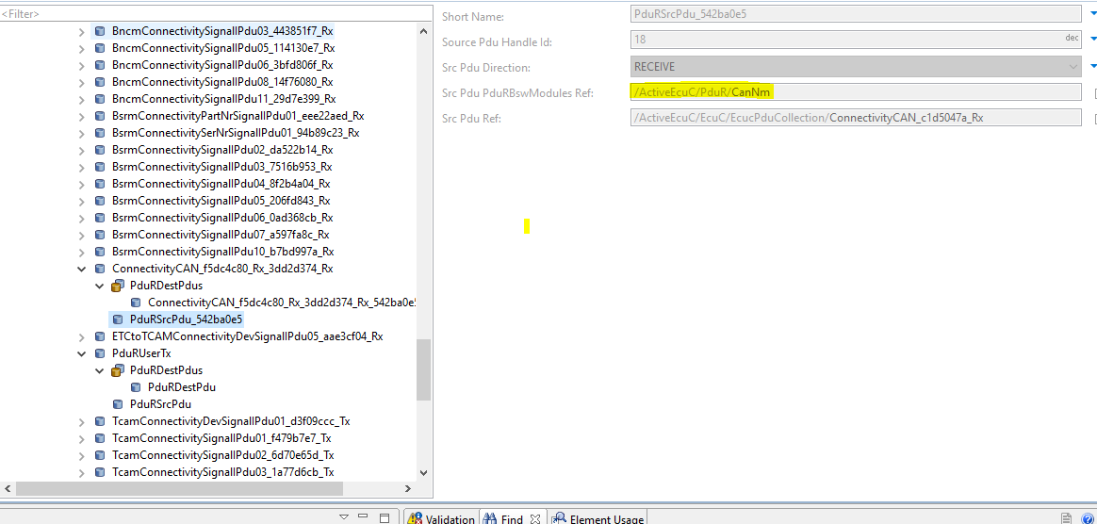
PNC implemented on DaVinciConfigurator
Config the NM user data from CAN NM to com on PduR module,target is CAN NM

Slide 12
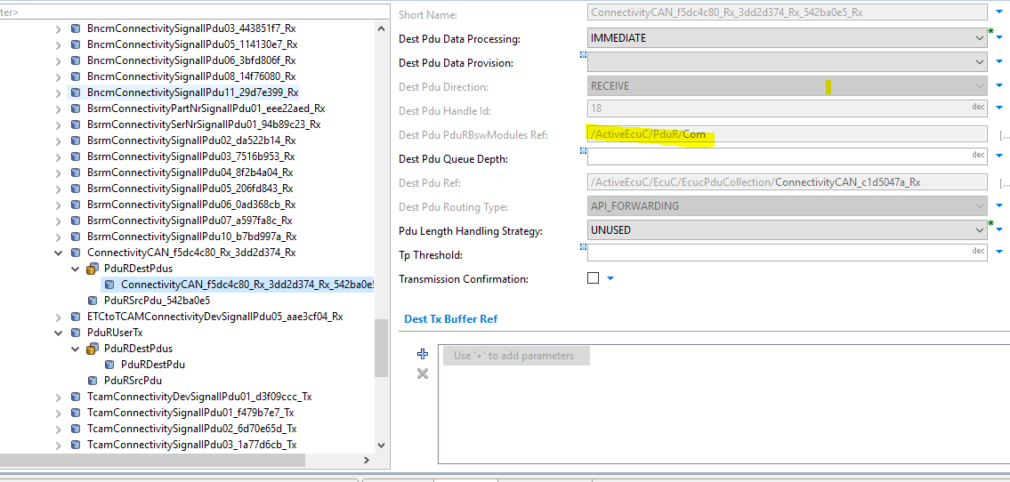
PNC implemented on DaVinciConfigurator
Config the NM user data from CAN NM to com on PduR module,destination is com.

Slide 13
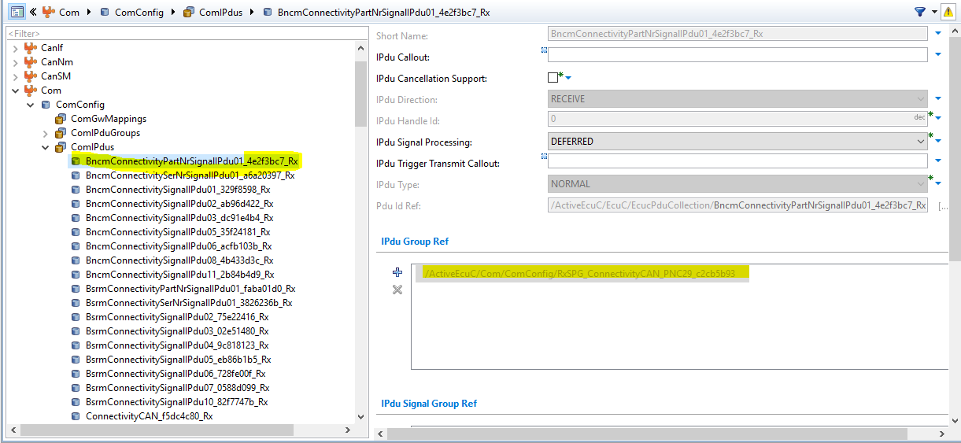
PNC implemented on DaVinciConfigurator
Config PDU mapping on com module,the PDU’ direct is receive

Slide 14
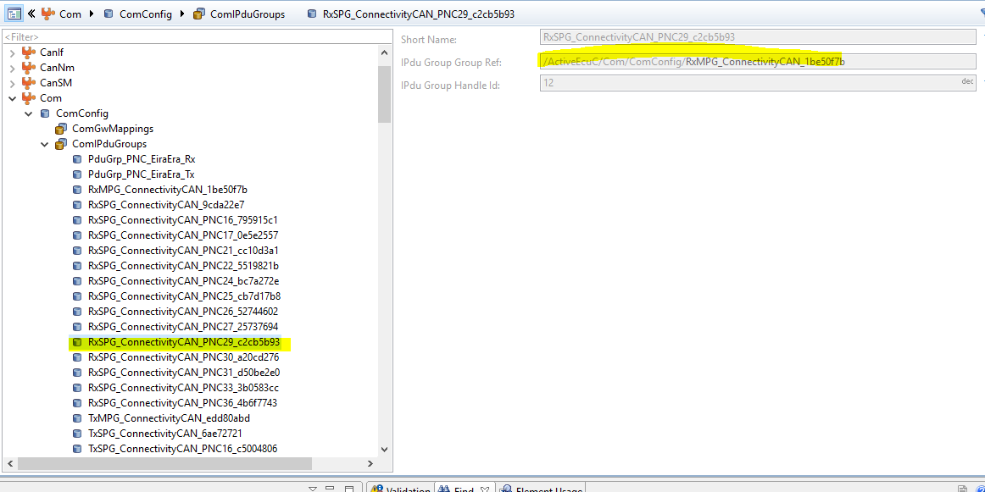
PNC implemented on DaVinciConfigurator
Config PDU mapping on com module,the mapping define on the ComIPduGroups

Slide 15
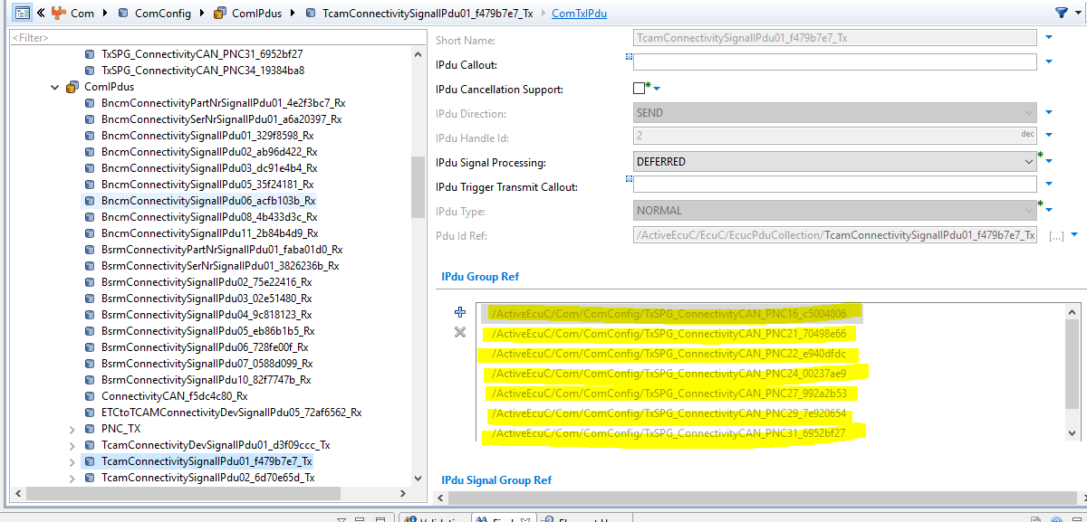
PNC implemented on DaVinciConfigurator
Config PDU mapping on com module,the PDU’ direct is transmit

Slide 16
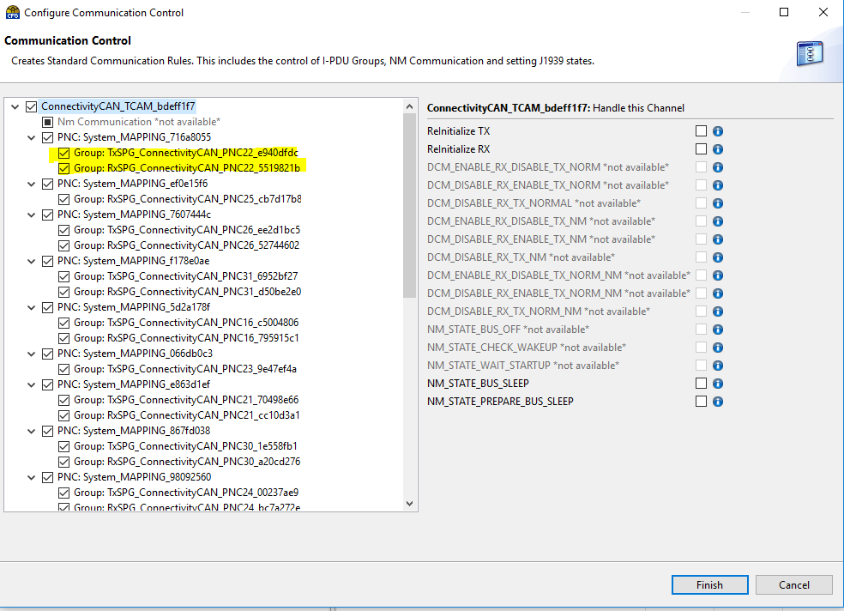
PNC implemented on DaVinciConfigurator
Enable the PNC mapping on BswM module

Slide 17
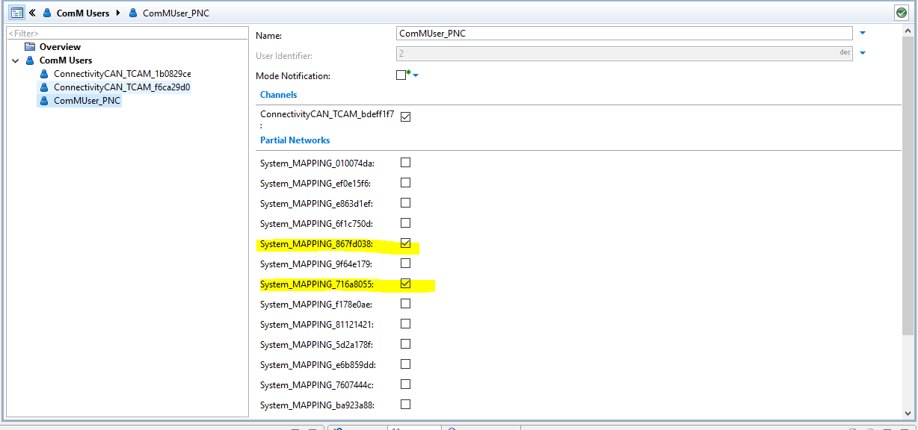
PNC implemented on DaVinciConfigurator
Config the PNC user on ComM

Slide 18
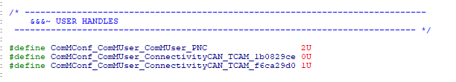
How to use the PNC user API
Request a PNC user
Release a PNC user

Slide 19
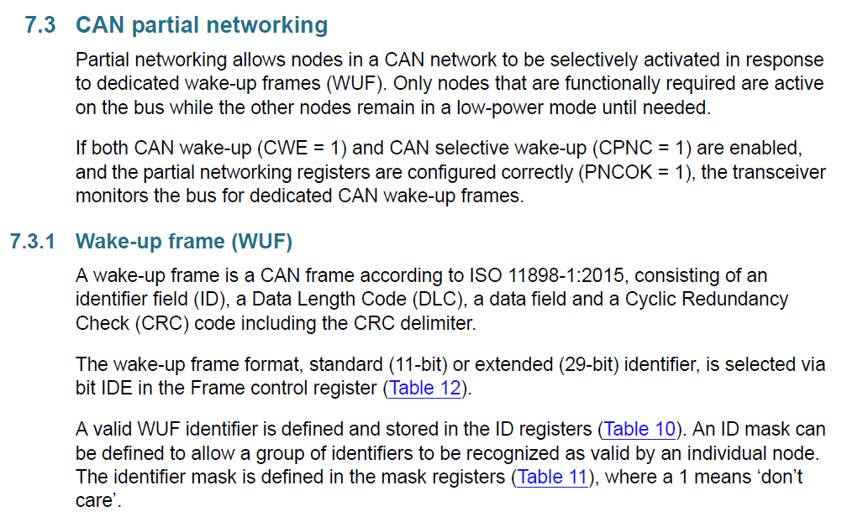
Requirements for CAN transceivers
Recommended CAN transceiver with PN function,Although the transceiver does not support the PN function, PNC can be implemented, but the software complexity is improved.The method is that when the MCU is wakuped by CAN transceiver,we need manually call the CAN driver to receive CAN messages, then filter the message.The standard autosar do not support the CAN message filter when wakeup.

